Slide 1
Single source
unweighted path lengths

Slide 2
Outline
This topic looks at another problem solved by breadth-first traversals
Finding all path lengths in an unweighted graph

Slide 3
Determining Distances
Problem: find the distance from one vertex v to all other vertices
Use a breadth-first traversal
Vertices are added in layers
The starting vertex is defined to be in the zeroeth layer, L₀
While the k^{th} layer is not empty:
All unvisited vertices adjacent to verticies in L_{k} are added to the (k + 1)^{st} layer
Any unvisited vertices are said to be an infinite distance from v
Reference: Kleinberg and Tardos

Slide 4
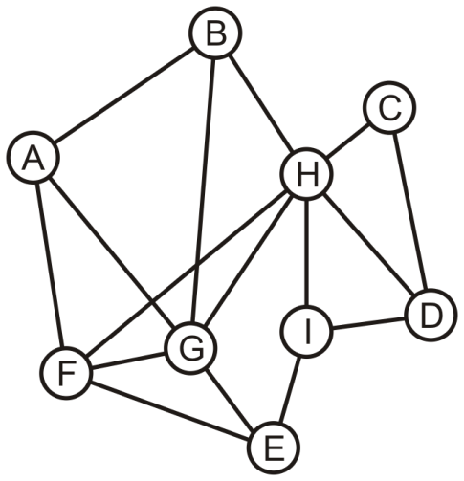
Determining Distances
Consider this graph: find the distance from A to each other vertex

Slide 5
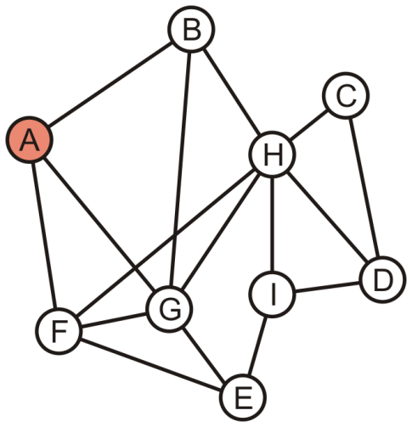
Determining Distances
A forms the zeroeth layer, L₀
A

Slide 6
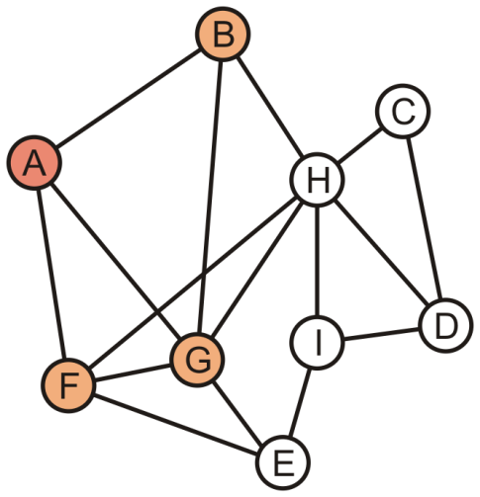
Determining Distances
The unvisited vertices B, F and G are adjacent to A
These form the first layer, L₁
B | F | G

Slide 7
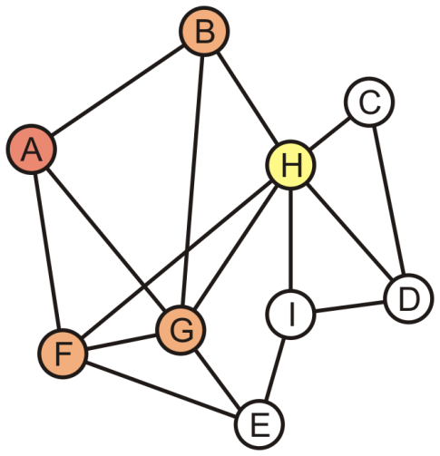
Determining Distances
We now begin popping L₁ vertices: pop B
H is adjacent to B
It is tagged L₂
F | G | H

Slide 8
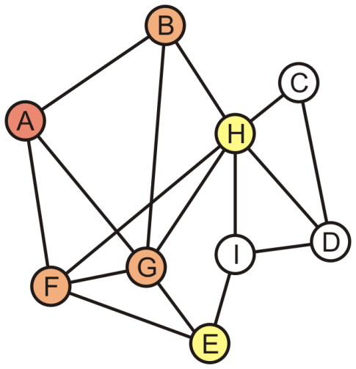
Determining Distances
Popping F pushes E onto the queue
It is also tagged L₂
G | H | E

Slide 9
Determining Distances
We pop G which has no other unvisited neighbours
G is the last L₁ vertex; thus H and E form the second layer, L₂
H | E

Slide 10
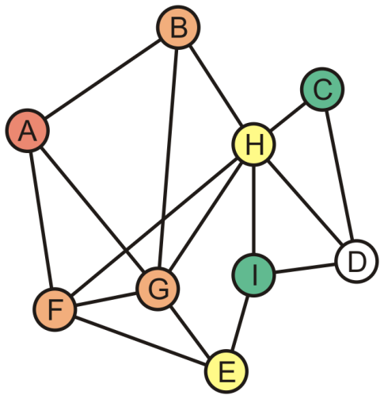
Determining Distances
Popping H in L₂ adds C and I to the third layer L₃
E | C | I

Slide 11
Determining Distances
E has no more adjacent unvisited vertices
Thus C and I form the third layer, L₃
C | I

Slide 12
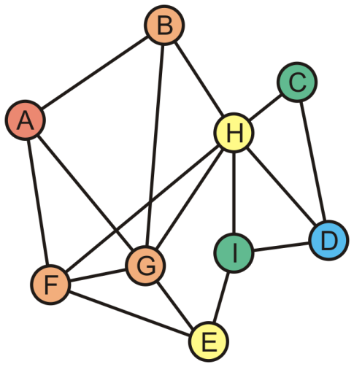
Determining Distances
The unvisited vertex D is adjacent to vertices in L₃
This vertex forms the fourth layer, L₄

Slide 13
Determining Distances
Theorem:
If, in a breadth-first traversal of a graph, two vertices v and w appear in layers L_{i} and L_{j}, respectively and {v, w} is an edge in the graph, then i and j differ by at most one
Proof:
If i = j, we are done
If i ≠ j, without loss of generality, assume i < j
Because v ∈ L_{i}, w does not appear in any previous layer, and {v, w} is an edge in the graph, it follows that w ∈ L_{i + 1}
Thus, j = i + 1
Therefore, i and j differ by at most one
Reference: Kleinberg and Tardos

Slide 14
Sumary
This topic found the unweighted path length from a single vertex to all other vertices
A breadth-first traversal was used
The first vertex is marked as layer 0
Vertices added to the queue by one in layer k are marked as layer k + 1
Later, we will see different algorithms for finding the shortest path length in weighted graphs

Slide 15
References
Wikipedia, http://en.wikipedia.org/wiki/Shortest_path
http://en.wikipedia.org/wiki/Breadth-first_search
[1] Jon Kleinberg and Éva Tardos, Algorithm Design, Addison Wesley, 2006, §§3.2-5, pp.78-99.
These slides are provided for the ECE 250 Algorithms and Data Structures course. The material in it reflects Douglas W. Harder’s best judgment in light of the information available to him at the time of preparation. Any reliance on these course slides by any party for any other purpose are the responsibility of such parties. Douglas W. Harder accepts no responsibility for damages, if any, suffered by any party as a result of decisions made or actions based on these course slides for any other purpose than that for which it was intended.

